Slide 1
AUTOMATIC LOAD CASE COMBINATION GENERATOR FOR ALTAIR HYPERMESH
Event
Presenter
Title
Date

Slide 2
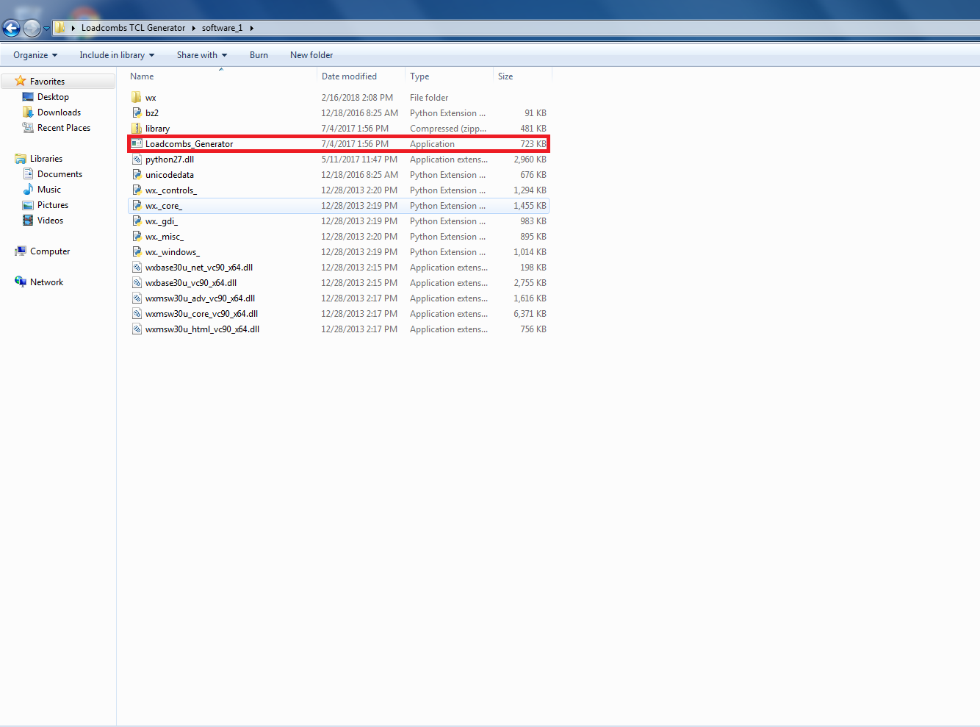
Working folder of macro tool
Do not delete any files from this folder. Run Loadcombs_Generator.exe for execution of tool while following the steps shown after this slide.

Slide 3
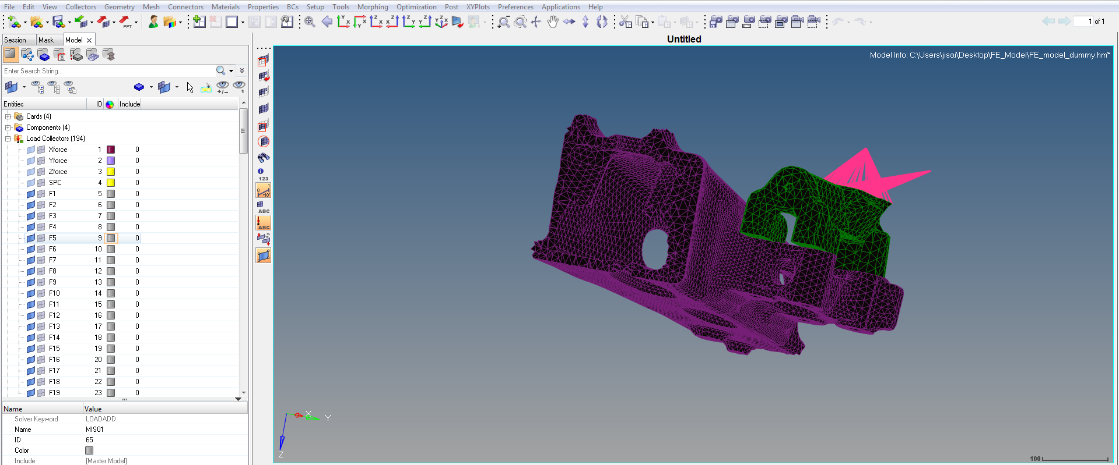
Steps to be followed
STEP 1
Prepare the unit load collectors in the Hypermesh. (Note that the unit load cases IDs here should be same as the ones in the csv file)

Slide 4
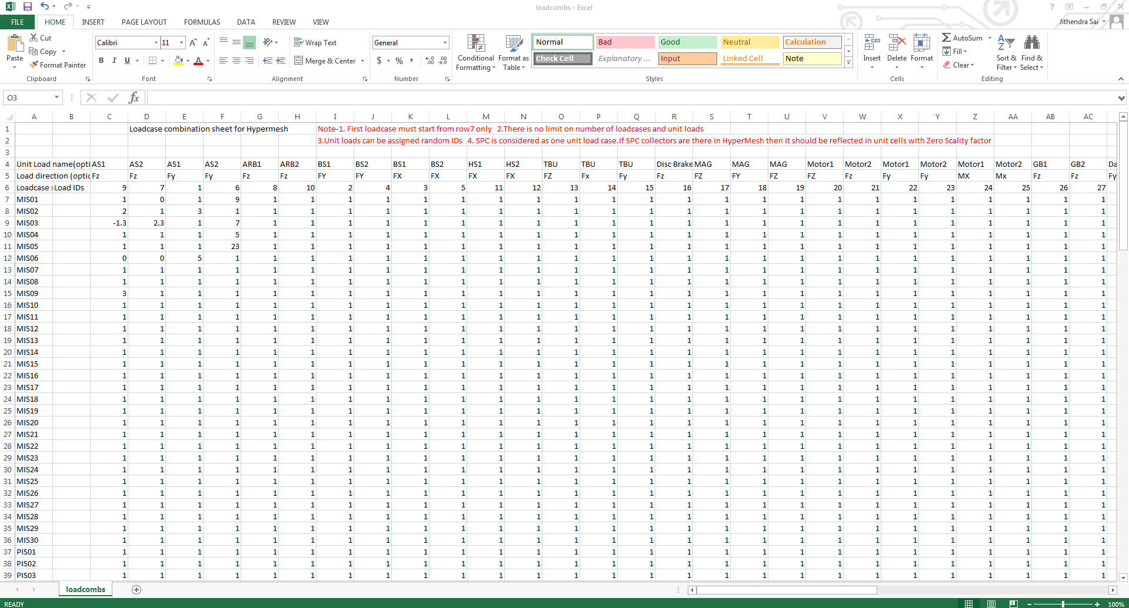
Contd.
STEP 2
Prepare the input csv file containing the load cases for a set of unit loads in the format as shown in the fig.
Read the instructions carefully.

Slide 5
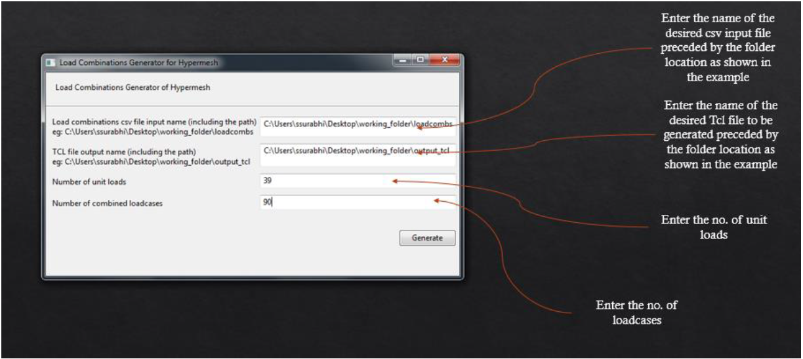
Contd.
STEP 3
Open the software and enter the following details as shown in fig.
STEP 4
Click generate to create the TCL file.

Slide 6
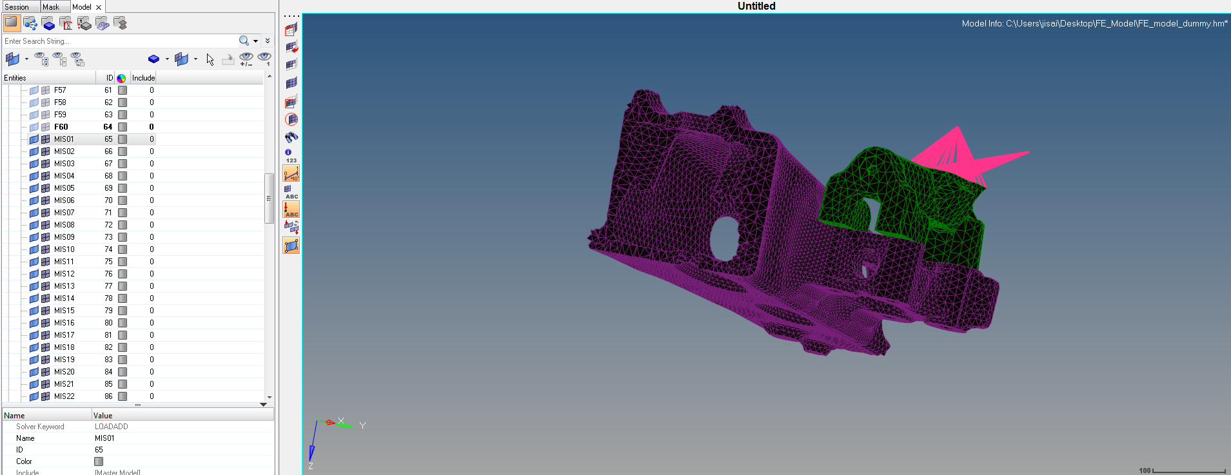
Contd.
STEP 5
Run the TCL file in Hyperworks. (File>Run>TCL script)
STEP 6
All the required load cases are generated in Hypermesh as shown in the fig.

